Slide 1
Assignment No 1

Slide 2
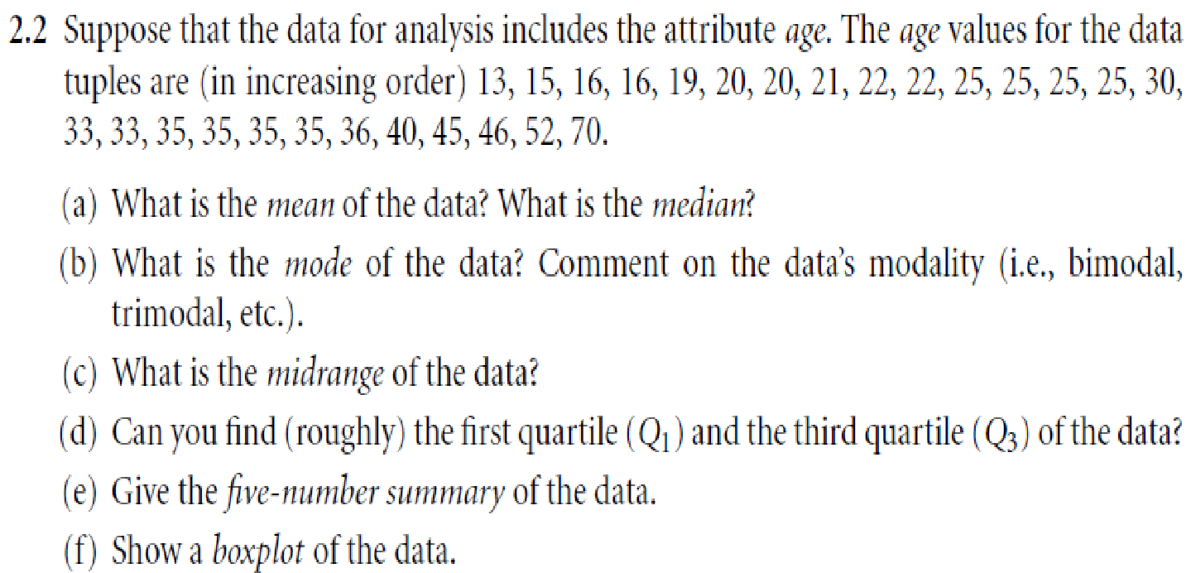
Q1.
‹#›
Notes:
‹#›

Slide 3
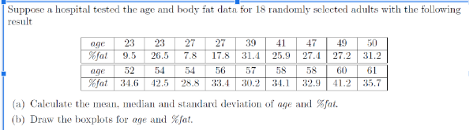
Q2.

Slide 4
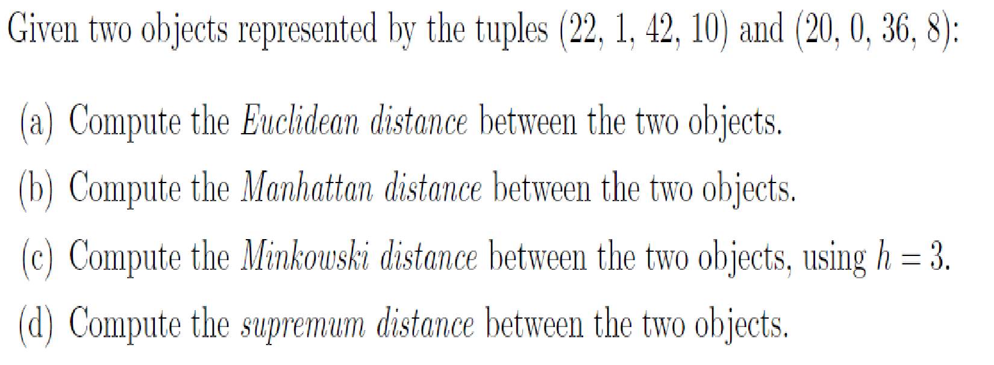
Q3.

Slide 5
Q4.
Find the similarity between two documents represented by vectors – ‘x’ and ‘y’, using Cosine Similarity. The ‘x’ vector has values, x = { 3, 2, 0, 5 }
The ‘y’ vector has values, y = { 1, 0, 0, 0 }

Slide 6
Q5.
Group of 12 sales price record as follows: 5,10,11,13,15,35,50,55,72,92,204,215 Partition them into 3 bins by each of the following methods:
Equal –frequency (equal – depth) partitioning
Smoothing by bin mean
Equal width Partitioning

Slide 7
Q6.
Normalize the following group of data: 200,300,400,600,1000
Min max normalization by setting new min=0 and max=1
Z-Score normalization
Z-score using mean absolute deviation
Normalize by decimal scale

Slide 8
Q7.
A group of students were classified in terms of personality (introvert or extrovert) and in terms of color preference (red, yellow, green or blue) with the purpose of seeing whether there is an association (relationship) between personality and color preference
(Observed counts) | Colors
 | Red | Yellow | Green | Blue | Totals
Introvert personality | 20 | 6 | 30 | 44 | 100
Extrovert personality | 180 | 34 | 50 | 36 | 300
Totals | 200 | 40 | 80 | 80 | 400

Slide 9
Q8.
Find Karl Pearson’s Coefficient of correlation for :
Student | 1 | 2 | 3 | 4 | 5
Maths | 5 | 7 | 9 | 3 | 6
Science | 6 | 6 | 8 | 1 | 5

